Slide 1
E-mail Marketing
By Mrs. Dipti Pawade

Slide 2
E-mail Marketing
Causes behind using E-mail Marketing
Branding with signature blocks
Letting autoresponders do the work
Speeding response time with packaged blurbs

Slide 3
E-mailing like a pro
From line
Subject line
Message Text
Signature block

Slide 4
Group e-mail
1. Group e-mail is useful for such things as:
Notifying registrants in a course, conference, program, or other event
Communicating with dealers, distributors, or franchisees
Sending routine service reminders or product recalls
Reminding customers of appointments or item pickups
Distributing information to journalists
Communicating with committees, board members, or employees
Announcing availability of products on back order
2. Dealing with spamming

Slide 5
Rolling Out E-Mail Newsletters
As an e-mail marketer, you must find the people who want your special offers, hot gossip, or the latest news delivered to their electronic doorstep; get them to sign up for your distribution service; and then encourage them to follow through with a click to your site.

Slide 6
Improving the efficacy of your newsletter
Bounce rate
Open rate
Unsubscribe rate
Click-through rate
A/B testing

Slide 7
Video and Vlogs
Youtube success story
Vlogs: Personal video journals, called vlogs, differ from other types of video: They are updated regularly, posted like blogs, often distributed through RSS feeds, and may contain additional text data.
Like blogs, they generally include personal reflections and experiences.

Slide 8
Video and Vlogs
For marketers, the trick is to tap into the video audience in one of four ways:
Advertising on various sites.
Posting your own vlog as an ongoing video saga, perhaps one that is quirky enough to be part of a viral marketing campaign.
Creating your own videos for product demonstrations, training, support, or promotion and posting them online and on your own site.
Tapping into the creative potential of your target audience by getting them to post videos about your company or products, perhaps as part of a contest.

Slide 9
Video considerations
There are a few steps to take:
1. View some videos and vlogs to get ideas from other businesses.
2. Decide whether you want to create your own videos or whether you want others to participate interactively with consumer-generated video content.
3. Assess your target market to decide where you want to post your videos.
4. Decide who will produce your videos and how much it will cost.
5. Before you commit to production, review your ROI projections to ensure that the effort will be worthwhile.

Slide 10
Video and Vlogs
Movie, sports, entertainment, and music sites are obvious candidates for videos: Post trailers, teasers, concert samples, or game excerpts.
You can also use videos for product updates, industry news, or helpful, do-it-yourself, training clips.

Slide 11
Video and Vlogs
Post your video on multiple sites to generate links from new prospects, and to add value to your inbound link campaign . Whether you create your own videos or recruit responses, pay attention to the demographics of the sites on which you post.
List all locations of your video clips in directories and search engines. Google allows users to play YouTube videos directly from search results, and posts thumbnails of video from other sites within natural search.
Many companies now run contests, inviting users to post video that promotes their product or service.
Concentrate on video quality and appearance

Slide 12
Webcasts, Web Conferences, and Webinars
Webcasts
Generally, a Webcast refers to a live, video-only, Internet broadcast.
Inherently passive, it’s delivered from one speaker to many listeners, often 50 or more.
Of the three techniques, Webcasts work best in a B2C environment for concerts, lectures, dance, comedy, theater, performance art, sports, events, entertainment, and the actual delivery of educational or training content.

Slide 13
Webcasts, Web Conferences, and Webinars
Web conferences
Web conferences work best with small group presentations that are data or document driven. They support two-way interaction, such as in an online focus group or a presentation near the close of the sales cycle.
Conferences generally involve some combination of two-way audio teleconferencing, live desktop-based whiteboards, PowerPoint presentations, and instant messaging or chat software.

Slide 14
Webcasts, Web Conferences, and Webinars
Webinars are the most-complex format, mixing and matching such multimedia components as a one-way audio conference, video, PowerPoint or whiteboard presentations, live polls or surveys, and one-way instant messaging for participants to submit questions.
Designed to reach a large number of participants over a widespread geographic region, Webinars generally require a sequence of activities to be successful: promotion, registration, confirmation e-mails, reminder e-mails, thank-you messages, and feedback surveys.
Consider these as premium branding and lead generation opportunities.

Slide 15
MOBILE MARKETING
Mobile marketing:
“A set of practices that enables organizations to communicate with and engage with their audiences in an interactive and relevant manner through and with any mobile device or network.”

Slide 16
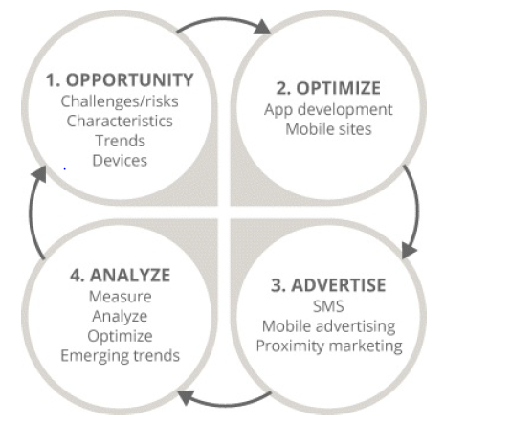
Steps of MOBILE MARKETING

